Slide 1
MaJicK Migration
Malik Awan
Justin Parker
Karika Shah

Slide 2
Objectives
Investigate the change in migrating pattern
Influence of environmental factors on migrating pattern
Arctic Terns
Blue Whales
Monarch Butterflies
Humpback Whales
Trend Analysis for
Notes:
We went into this project hopeful that we would be able to tie changes in the migration patterns of several species to yearly changes in climate

Slide 3
Resources
Datasets
Visual Graphics
OBIS-SEAMAP (http://seamap.env.duke.edu/)
iNaturalists (https://www.inaturalist.org/)
Matplotlib
Google Cloud Platform
Notes:
OBIS-SEAMAP, Ocean Biogeographic Information System Spatial Ecological Analysis of Megavertebrate Populations, is a spatially referenced online database, aggregating marine mammal, seabird, sea turtle and ray & shark observation data from across the globe.
iNaturalist helps you identify the plants and animals around you. Get connected with a community of over 750,000 scientists and naturalists who can help you learn more about nature!

Slide 4
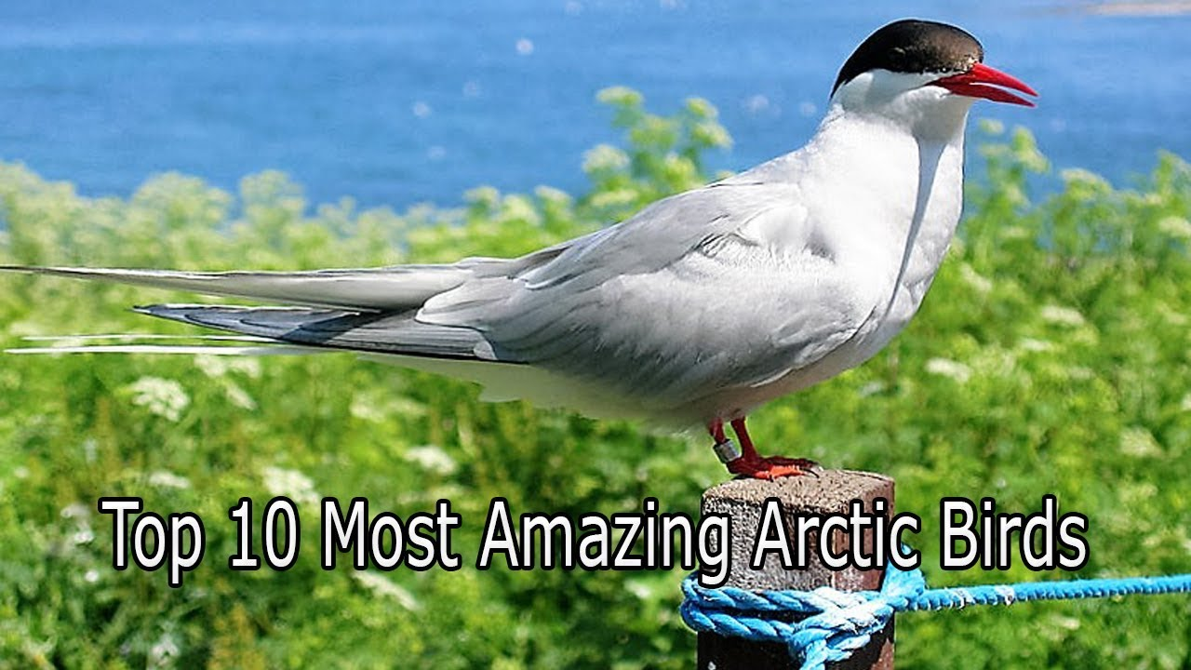
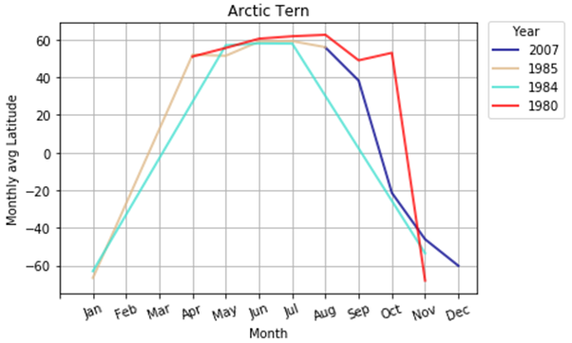
Arctic Tern
Notes:
They breed in from Nov through Jan in South pole

Slide 5
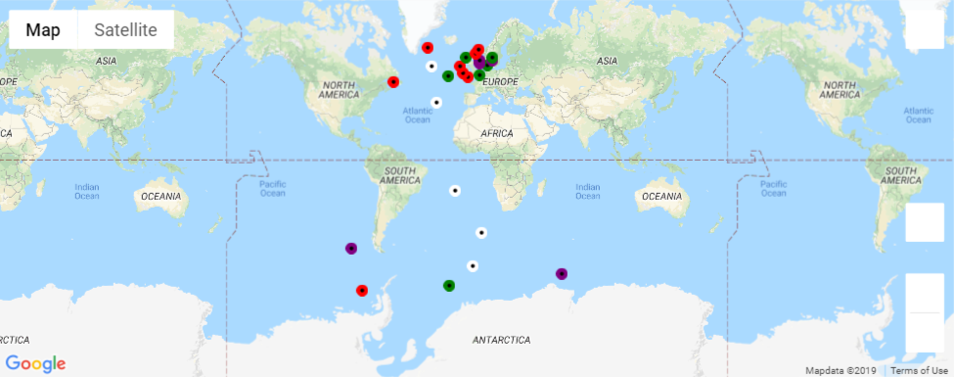
Arctic Tern
Legend
Color | Year
White | 2007
Green | 1985
Purple | 1984
Red | 1980

Slide 6
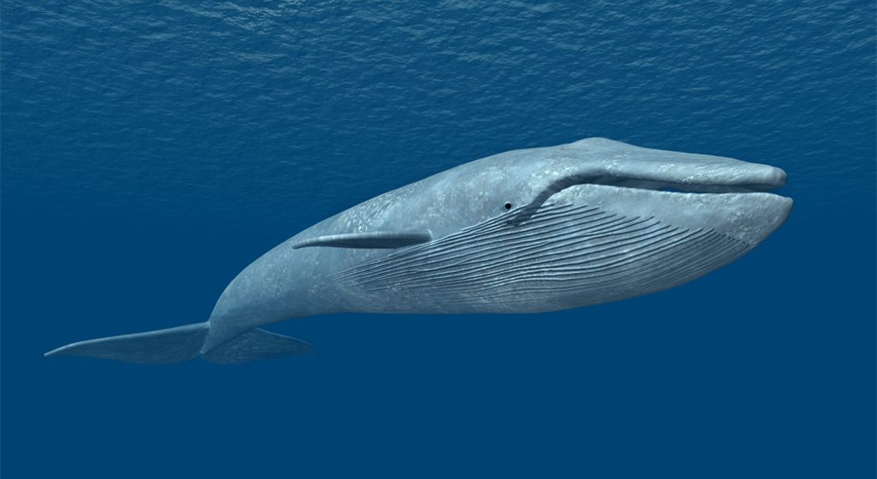
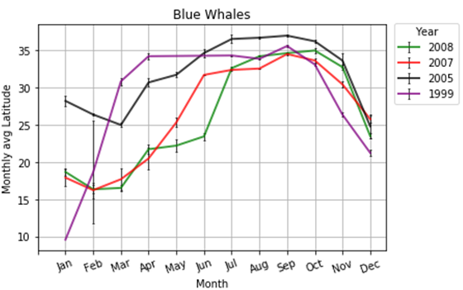
Blue Whales

Slide 7
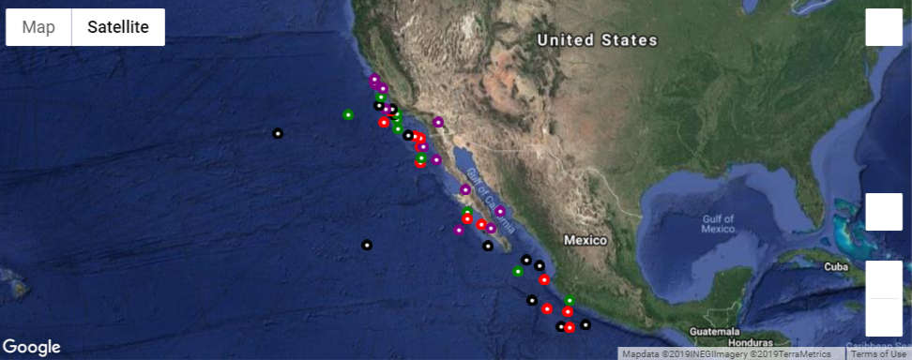
BLUE WHALES
Legend
Color | Year
Black | 2008
Red | 2007
Purple | 2005
Green | 1999

Slide 8
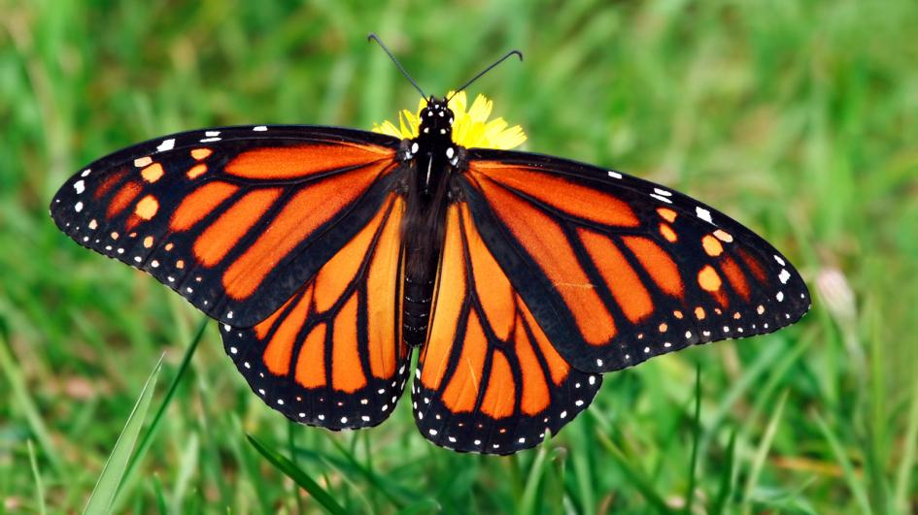
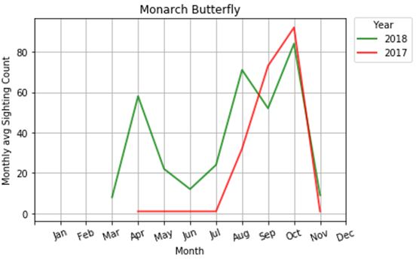
Monarch Butterfly

Slide 9
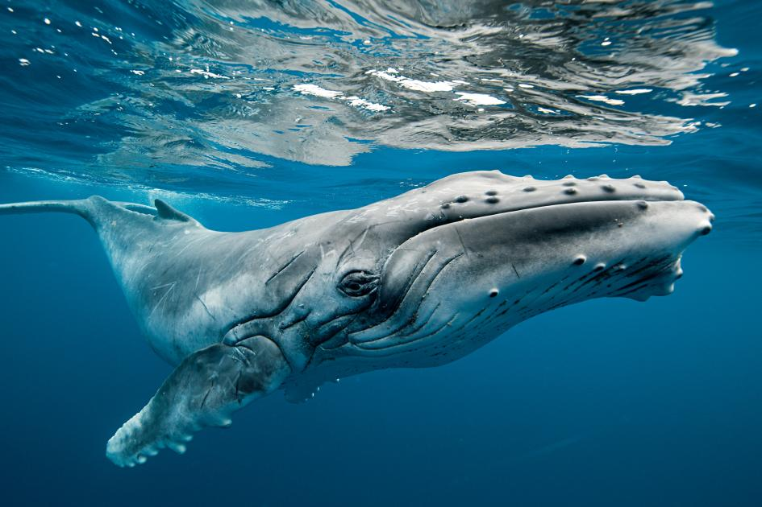
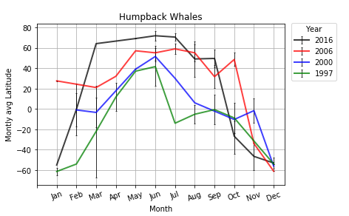
Hump-back Whale

Slide 10
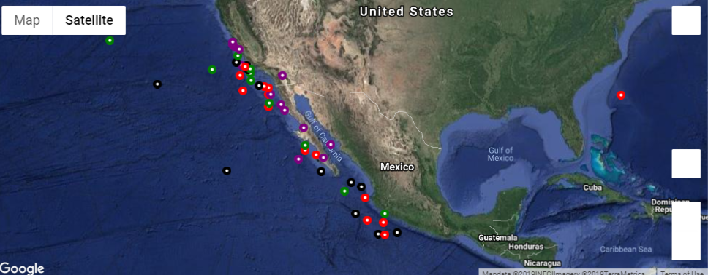
Hump-back Whale
Legend
Color | Year
Black | 2016
Red | 2006
Purple | 2000
Green | 1997

Slide 11
Summarize
Arctic Terns
Migrate yearly between poles
No apparent change in pattern
Blue Whales
Some migratory change over time
Winter - Return to the same latitudes
Humpback Whales
Trending north - Spring & Summer
Winter - Return to the same latitudes
Notes:
Conclusion could be different if we had the weather data : Due to government shutdown, we could not get to show if the climate change impacted the migratory pattern
A further investigation into the correlation between the trends and climate change would help in making a more substantial conclusion
Arctic Terns migrate yearly between the north and south pole
No apparent change to pattern over time
Blue Whales have shown some migratory change over time
Return to the same latitudes during the winter months
Humpback Whales are trending north during Spring and Summer
Appear to return to the same latitude during Winter

Slide 12
Thank you

